Slide 1

Node.js Security
Best Practices
Tre’ Grisby
@Trewaters
Government IT Professional
@JavaScriptDojo
November 2018
Notes:
Not endorsing hacking.

Slide 2

Tre’ Grisby contact information
Talking Points
Don’t be afraid, I will melt your brain
No Rulez!
All items are GUIDELINES !
Node.js is part of an ecosystem
Twitter ( @trewaters )
LinkedIn ( linkedin.com/in/trewaters )
Monthly Meetup “Berkeley JavaScript Dojo” ( meetup.com/Berkeley-Javascript-Dojo )
Google+ ( plus.google.com/+TreGrisby )
Notes:
About me…
Work history (Jack of all trades)
What I love…
Security,
“Technology Fairy” Anything new and shiny.
Roleplaying games like Shadowrun or Dungeons & Dragons, Online gaming conventions,
Skateboarding,
Digital Cash like (bitcoin, Dash, Pivx).
What version of Node.js has LTS support?
( v6 and v10 )
What is the latest version of Npm?
( v6.4.1 ) as of 2 months ago

Slide 3
Quick Outline
Layers of security
Specific Threats
Community Expectations

Slide 4

OWASP
The “Open Web Application Security”
List Top 10 Application Security Risks in 2017
November 5th meetup in ( San Francicso )
November 13th meetup in ( Los Altos )
November 14th meetup in ( San Francisco )
( meetup.com/Bay-Area-OWASP )

Slide 5



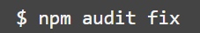
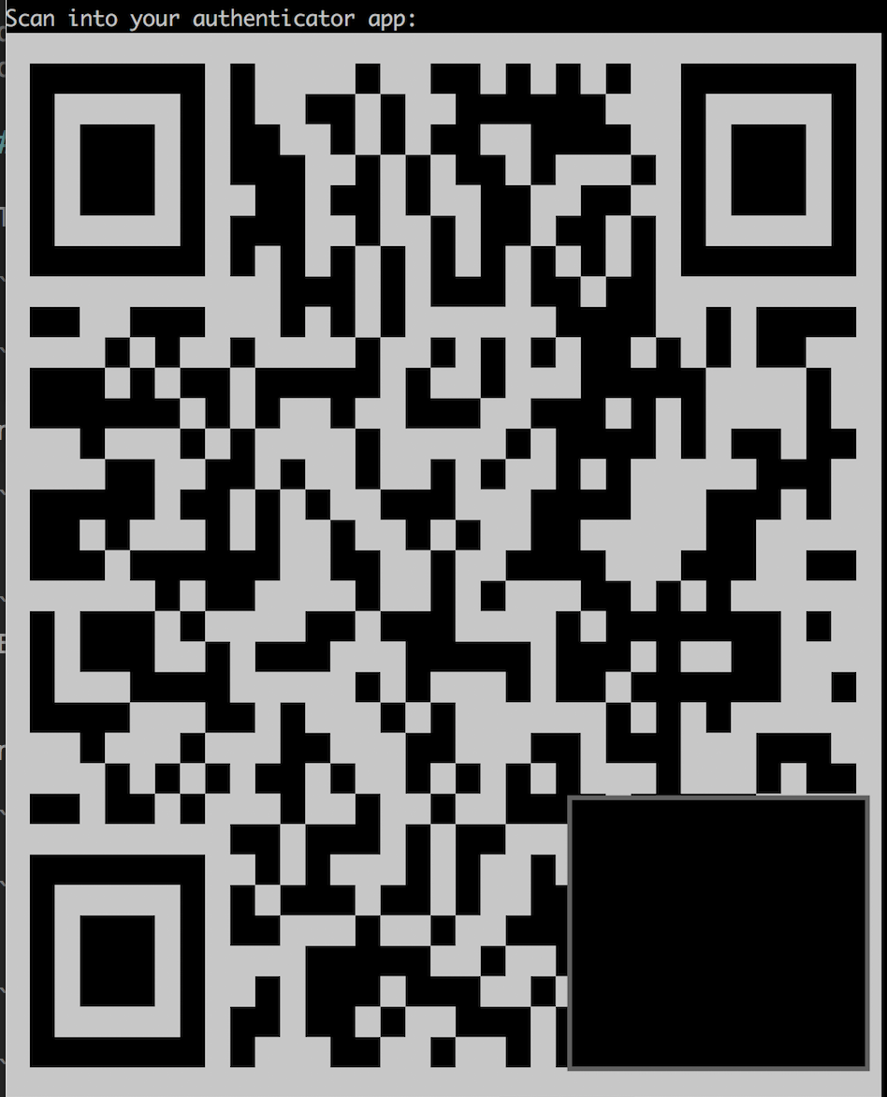


Node packet manager
Security Audits, available in npm v6
Two-Factor Authentication ( 2fa )
One Time Password ( OTP ), Authy or Google Authenticator
Recover your 2fa and OTP
Yarn should work with 2fa

Slide 6
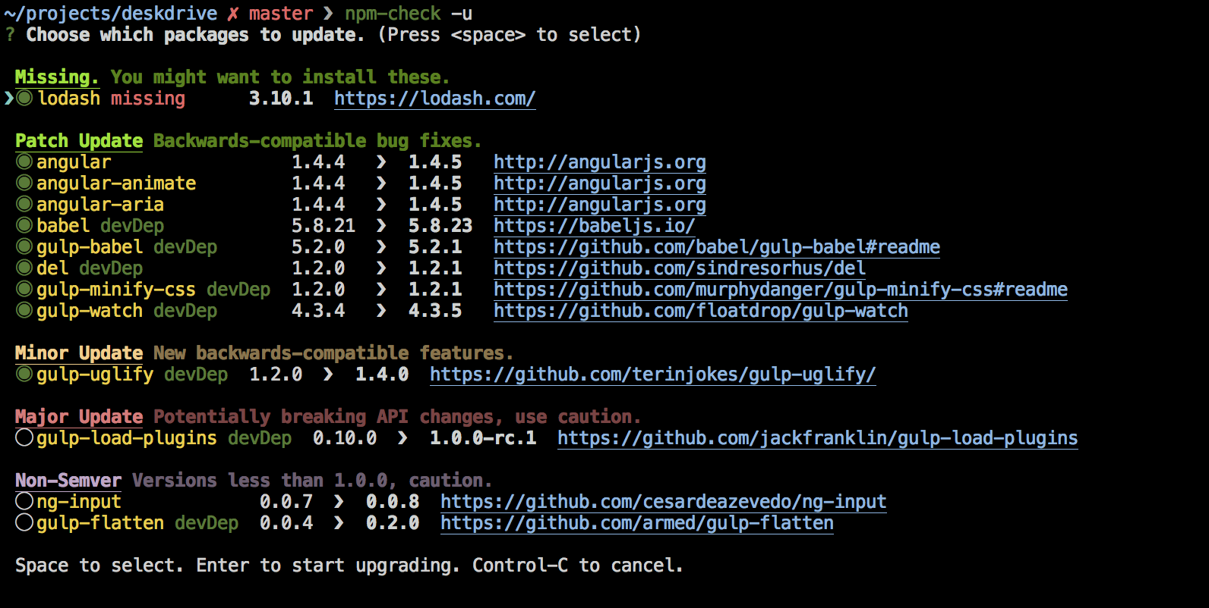
npm-check
Check for outdated, incorrect, and unused dependencies
Research your changes

Slide 7

Embrace Linter Security Rules
TSLint
(security plugins)
ESLint
Unsafe regexp
Buffer noassert
Child process
Disable mustache escape
Eval with expression
No csrf before method override
Non literal fs filename
Non literal regexp
Non literal require
Html injection
Possible timing attacks
Pseudo random bytes
SQL literal injection
Non literal buffer
Unsafe regex
Buffer noassert
Child process
Disable mustache escape
Eval with expression
csrf before method override
Non literal fs filename
Non literal regexp
Non literal require
Object injection
Possible timing attacks
PseudoRandomBytes

Slide 8
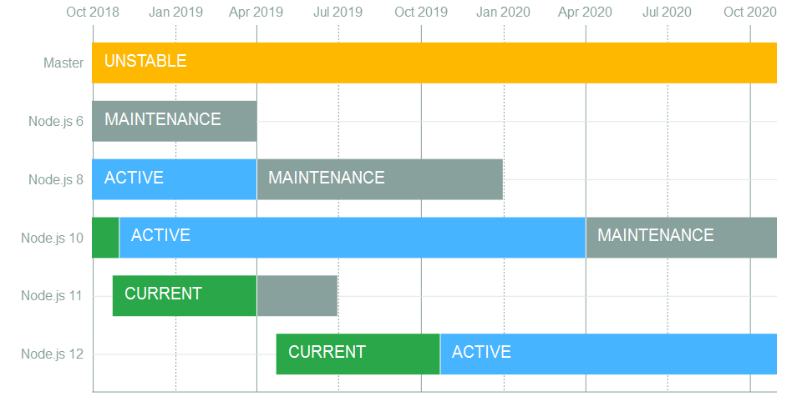
Security Patches
Use even versions of Node.js… please
“Release Working Group”
Current, Active, Maintenance… Release
Long Term Support ( LTS )
3 years from Current to EOL
End of Life ( EOL )
Track updates with “SemVer”!
“Semver”...?
Notes:
“Use even versions of Node.js for enterprise software”
Node 6.x EOL scheduled for April 2019
Node 10.x EOL scheduled for April 2021
Node 11.x EOL scheduled for June 2019
- LTS gets Bug fixes, security updates, non-semver-major npm updates
Do not use EOL versions they are no longer getting security updates or patches

Slide 9
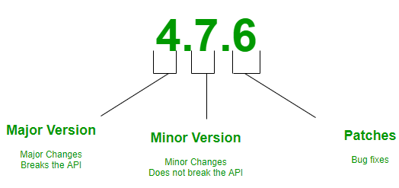
Semantic Versioning ( Semver )
Major . Minor . Patch
Notes:
Given a version number MAJOR.MINOR.PATCH, increment the:
- MAJOR version when you make incompatible API changes,
- MINOR version when you add functionality in a backwards-compatible manner, and
- PATCH version when you make backwards-compatible bug fixes.
Additional labels for pre-release and build metadata are available as extensions to the MAJOR.MINOR.PATCH format.

Slide 10
OWASP Top 10 Threats
Injection
Broken Authentication
Sensitive Data Exposure
XML External Entities (XXE)
Broken Access Control
Security Misconfiguration
Cross-Site Scripting (XSS)
Insecure Deserialization
Using Components with Known Vulnerabilities
Insufficient Logging & Monitoring
( www.owasp.org/index.php/Category:OWASP_Top_Ten_2017_Project )

Slide 11

Notes:
Don’t Worry, Be Happy

Slide 12
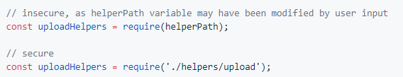
OWASP Top 10 Threats
1) Injection
Prevent query injection vulnerabilities
Use ORM/ODM libraries like Mongoose
Avoid JavaScript `eval` statements and `new Function`
eval()
new Function
Avoid module loading using a variable

Slide 13
OWASP Top 10 Threats
2) Broken Authentication
Avoid using the Node.js crypto library for handling passwords
use “bcrypt”
Support blacklisting JWT tokens
look up Randall Degges “JWT Suck (and are stupid)”
Limit the allowed login request of each user
use “express-brute”

Slide 14
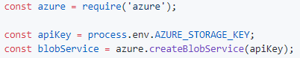
OWASP Top 10 Threats
3) Sensitive Data Exposure
Extract secrets from config files or use packages to encrypt them
use “cryptr”
configure .gitignore
use Environment variables

Slide 15
OWASP Top 10 Threats
4) XML External Entities (XXE)
Run unsafe code in a sandbox
use a cloud serverless framework
use libraries like “sandbox” or “vm2”
Take extra care when working with child processes
use child_process.execFile if you are unsure

Slide 16
OWASP Top 10 Threats
5) Broken Access Control
Run Node.js as non-root user

Slide 17
OWASP Top 10 Threats
6) Security Misconfiguration
Adjust the HTTP response headers for enhanced security
use “helmet”
Hide error details from clients
set NODE_ENV to production
Modify session middleware settings
use “helmet” for express servers

Slide 18
OWASP Top 10 Threats
7) Cross-Site Scripting (XSS)
Escape HTML, JS, and CSS output
use “escape-html”
use “node-esapi”

Slide 19
OWASP Top 10 Threats
8) Insecure Deserialization
Validate incoming JSON schemas
use “jsonschema”
use “joi”
Limit payload size using a reverse proxy or middleware.
configure express “body parser” to accept small-size payloads

Slide 20
OWASP Top 10 Threats
9) Using Components with Known Vulnerabilities
use npm audit fix
use “npm-check”

Slide 21


OWASP Top 10 Threats
10) Insufficient Logging & Monitoring
Notes:
- Don’t be the one with video cameras that no one is watching or recording.
- example logging in as admin when there shouldn’t be any admins logging in.

Slide 22

Threats in the wild
Electron.js was exploited. You should be using version 2 or higher
Node.js Integration
( http://bit.ly/2OhUrKs ) #2 item in the list
Reverse Shell attack through using eval()
( http://bit.ly/2yN943x )
Common Vulnerabilities and Exposure (CVE)
( http://bit.ly/2Rv8Hlc )

Slide 23

NodeGoat
Deploy on Heroku and check for exploits.
NodeGoat has a guide on ways to fix its vulnerabilities
github.com/OWASP/NodeGoat
Notes:
OWASP initiative

Slide 24

Notes:
Don’t be this person!

Slide 25

Disclose vulnerabilities
Report issues:
email ( security@nodejs.org )
website ( hackerone.com/node.js )
more security info here ( nodejs.org/en/security )
security.md
Add to repo
How should someone report issues ( github.com/securitytxt/security-txt )
Notes:
- Beware how you disclose publicly.
- You could be breaking the law if you are sharing vulnerabilities incorrectly. What is the right way? I don’t know but I recommend
- https://www.owasp.org/index.php/Vulnerability_Disclosure_Cheat_Sheet

Slide 26
acknowledgements
i0natan
( https://github.com/i0natan/nodebestpractices )
Thomas Hunter II
( https://medium.com/intrinsic/common-node-js-attack-vectors-the-dangers-of-malicious-modules-863ae949e7e8 )

Slide 27


Hiring
Mid to Senior Level Engineer
Ruby on Rails code base,
new projects in React.js
Located near Downtown Berkeley BART station
Twitter ( @Magoosh )
Magoosh.com

Slide 28
Finished… The End…
Slides and Notes
github.com/Trewaters/SFNode-Nov-2018

